Slide 1

Linux Fundamentals VERSION 3 Part 5 Eng Ali Mohammad. Bani Bakkar

Slide 2
scripting

Slide 3
Script
A command script is simply a file, which contains a set of normal linux commands that the command shell will perform automatically in the given order.
Compared to real programming languages, like python, perl or c, programming with linux (bash, tcsh, csh or sh) is computationally rather ineffective.

Slide 4
Writing Your First Script and Getting It to Work
To successfully write a shell script, you have to do three things:
Write a script (nano, bash ,gedit)
Give the shell permission to execute it (chmod +x filename)
Put it somewhere the shell can find it
./filename ---- bash filename

Slide 5
First program
#!/bin/bash
# My first script
echo "Hello World!“
Then
Setting Permissions
The next thing we have to do is give the shell permission to execute your script.
$ chmod 755 hello_world
$ ./hello_world
??? #!/usr/bin/python ???

Slide 6
Second Program
#!/bin/bash
A=“ali”
B=“mohammad”
Echo “my name is $A $B”

Slide 7
comment
#!/bin/bash
#
# Hello World Script
#
echo Hello World
Or
<<comment1
comment1

Slide 8
commands
Printf “hello my name Is ali” Printf “hello my name Is ali\n”
Printf “hello my name Is ali\n”
Printf “hello my name Is %s\n” ali
Printf “hello my name Is %s and my age %d\n” ali 40

Slide 9
variables
#!/bin/bash
#
# simple variable in script
#
var1=4
echo $var1
Scripts can contain variables, but since scripts are run in their own shell, the variables do not survive the end of the script.
$ echo $var1
$ ./vars
var1 = 4
$ echo $var1

Slide 10
Variables
Set variable in shell
A=5
A
5
Unset variable
Unset –v A
A
v=$(date) or v=`date`
Echo $v
Date

Slide 11
Arguments
Ls –l arg[0]=ls arg[1]=l
Ls –lah arg[0]=ls arg[1]=l arg[2]=a arg[3]=h
Example program
#!/bin/bash
Echo “welcome $1 $2 -------------- this file name is $0”

Slide 12
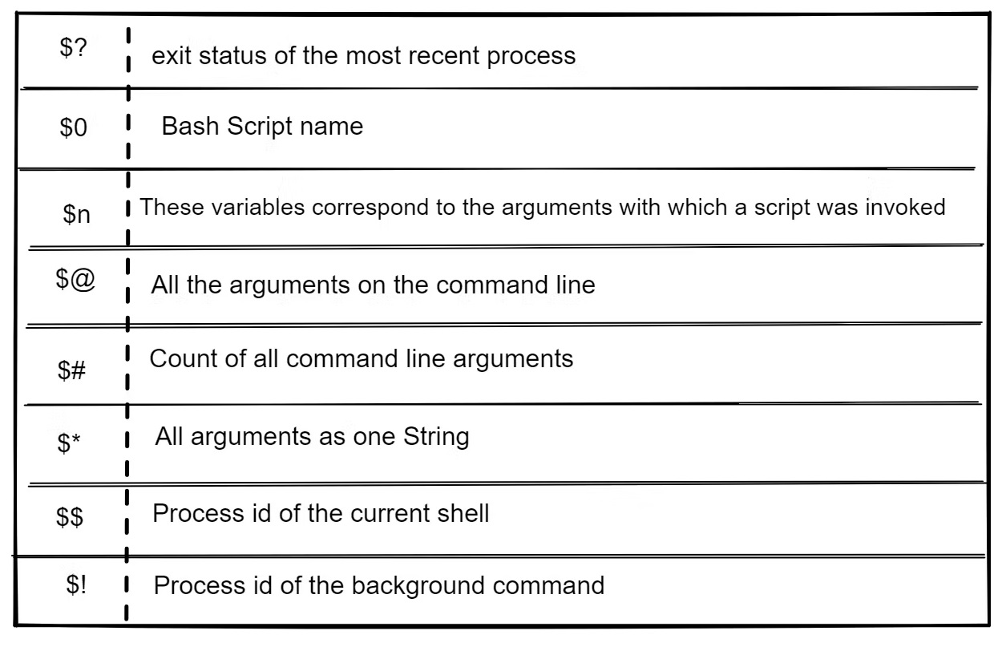
Special Shell Variables

Slide 13
Example
#!/bin/bash
Echo “hello”
Sleep 20
Kill -9 $$
Echo “done”

Slide 14
program
Name=ali #no spaces
Age=40 #no spaces
Echo “my name is ${name} and my age is ${age}”
Or
print “my name is %s and my age is %d” $name $age
Echo $name
Echo $age
Printf $name”\n”
Printf $age”\n”

Slide 15
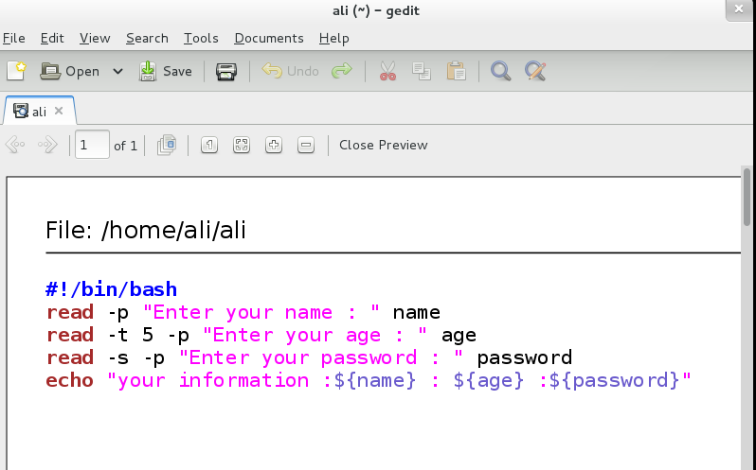
Read

Slide 16
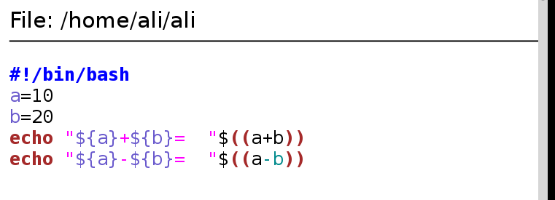
Mathematical Expressions

Slide 17
Security issue
Some user may try to perform setuid based script root spoofing. This is a rare but possible attack. To improve script security and to avoid interpreter spoofing, you need to add – after the #!/bin/bash, which disables further option processing so the shell will not accept anyoptions.
#!/bin/bash -
or
#!/bin/bash --
Any arguments after the -- are treated as filenames and arguments. An argument of – is equivalent to --.

Slide 18
if then else
If given condition is true then command1 is executed otherwise command2 is executed. Syntax:
if condition
then
condition is zero (true - 0) execute all commands up to else statement
else
if condition is not true then execute all commands up to fi
fi

Slide 19
if then else
The if then else construction is about choice. If a certain condition is met, then execute something, else execute something else.
#!/bin/bash
if [ -f isit.txt ]
then echo isit.txt exists!
else echo isit.txt not found!
fi
If we name the above script 'choice', then it executes like this.
$ ./choice
isit.txt not found!
$ touch isit.txt
$ ./choice
isit.txt exists!

Slide 20
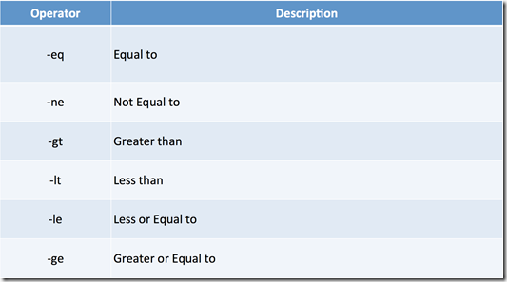
comparison operators

Slide 21
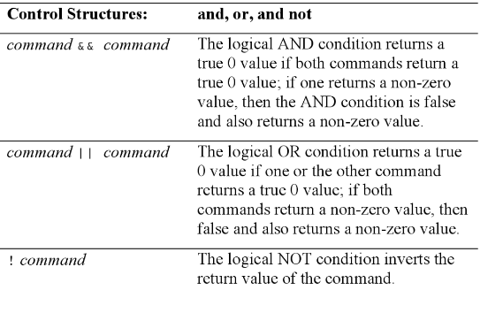

Slide 22
Primary | Meaning
[ -a FILE ] | True if FILE exists.
[ -b FILE ] | True if FILE exists and is a block-special file.
[ -c FILE ] | True if FILE exists and is a character-special file.
[ -d FILE ] | True if FILE exists and is a directory.
[ -e FILE ] | True if FILE exists.
[ -f FILE ] | True if FILE exists and is a regular file.
[ -g FILE ] | True if FILE exists and its SGID bit is set.
[ -h FILE ] | True if FILE exists and is a symbolic link.
[ -k FILE ] | True if FILE exists and its sticky bit is set.
[ -p FILE ] | True if FILE exists and is a named pipe (FIFO).
[ -r FILE ] | True if FILE exists and is readable.

Slide 23
[ -s FILE ] | True if FILE exists and has a size greater than zero.
[ -t FD ] | True if file descriptor FD is open and refers to a terminal.
[ -u FILE ] | True if FILE exists and its SUID (set user ID) bit is set.
[ -w FILE ] | True if FILE exists and is writable.
[ -x FILE ] | True if FILE exists and is executable.
[ -O FILE ] | True if FILE exists and is owned by the effective user ID.
[ -G FILE ] | True if FILE exists and is owned by the effective group ID.
[ -L FILE ] | True if FILE exists and is a symbolic link.
[ -N FILE ] | True if FILE exists and has been modified since it was last read.
[ -S FILE ] | True if FILE exists and is a socket.

Slide 24
[ FILE1 -nt FILE2 ] | True if FILE1 has been changed more recently than FILE2, or if FILE1 exists and FILE2 does not.
[ FILE1 -ot FILE2 ] | True if FILE1 is older than FILE2, or is FILE2 exists and FILE1 does not.
[ FILE1 -ef FILE2 ] | True if FILE1 and FILE2 refer to the same device and inode numbers.
[ -o OPTIONNAME ] | True if shell option "OPTIONNAME" is enabled.
[ -z STRING ] | True of the length if "STRING" is zero.
[ -n STRING ] or [ STRING ] | True if the length of "STRING" is non-zero.
[ STRING1 == STRING2 ] | True if the strings are equal. "=" may be used instead of "==" for strict POSIX compliance.
[ STRING1 != STRING2 ] | True if the strings are not equal.
[ STRING1 < STRING2 ] | True if "STRING1" sorts before "STRING2" lexicographically in the current locale.
[ STRING1 > STRING2 ] | True if "STRING1" sorts after "STRING2" lexicographically in the current locale.
[ ARG1 OP ARG2 ] | "OP" is one of -eq, -ne, -lt, -le, -gt or -ge. These arithmetic binary operators return true if "ARG1" is equal to, not equal to, less than, less than or equal to, greater than, or greater than or equal to "ARG2", respectively. "ARG1" and "ARG2" are integers.

Slide 25
if then elif
You can nest a new if inside an else with elif.
#!/bin/bash
count=42
if [ $count -eq 42 ]
then
echo "42 is correct."
elif [ $count -gt 42 ]
then
echo "Too much."
else
Echo "Not enough."
fi

Slide 26
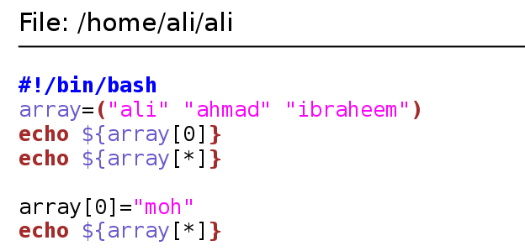
Array

Slide 27
for loop
for i in 1 2 4
do
echo $i
done
An example of a for loop combined with an bash shell.
#!/bin/bash
for counter in {1..20}
do
echo counting from 1 to 20, now at $counter
sleep 1
done

Slide 28
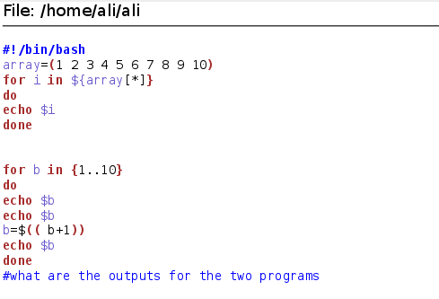
Example

Slide 29
mount
On Linux and UNIX operating systems, you can use the mount command to attach (mount) file systems and removable devices such as USB flash drives at a particular mount point in the directory tree.
The umount command detaches (unmounts) the mounted file system from the directory tree.
Use Df -h

Slide 30
mount
To mount cdrom on media directory
Mount /dev/cdrom /media
To mount cdrom on cdrom directory
Mount /dev/cdrom /cdrom

Slide 31
Archive and compression

Slide 32
Archive
tar
The program tar originally stands for Tape Archive, it was used to back up data to tape drives. A pure tar archive is not compressed.
Create an archive with files or folder:
tar cfv archive.tar file1 file2 file3
(c = create , f = file, v = verbose)
all files of an archive:
tar tvf archive.tar
To read the contents of archive file :
tar tf archivefile
Extract an archive:
tar xfv archive.tar
(x = extract)
Change the extract location
tar xfv archive.tar -C /location/
Use du file –hs (to know te size of the file or directory)

Slide 33
compression
As we know, a tar archive is not compressed without additional options, this can be done with the additional option gzip. gzip stands for GNU zip and the file vextension .gz is appended to the tar archive.
Create a compressed file:
gzip file
Result: file.gz
Decompress a file:
gunzip file
Combining files in a compressed archive:
tar cfvz archive.tar.gz file1 file2 (z = compress with gzip)Show )
Result: archiv.tar.gz
Decompress and extract an archive:
tar xfvz archive.tar.gz

Slide 34
Compression 2
bzip2:
Create a compressed file:
bzip2 file
Result: file.bz2
Decompress a file:
bunzip2 file.bz2
Combining files in a compressed archive:
tar cfvj archive.tar.bz2 file1 file2
Result: archive.tar.bz2
Decompress and extract an archive:
tar xfvj archive.tar.bz2
xz ??? (use J instead of j)

Slide 35
zip
The tool zip is mainly used in Windows , but is also available for Linux-based operating systems.
Combining individual files in a compressed archive:
zip archive.zip file1 file2
Combining complete folders in a compressed archive:
zip -r archive.zip folder1 folder2 folder3
Decompress and extract an archive:
unzip archive.zip
Show all files of an archive:
unzip -l archive.zip

Slide 36
networks
Ifconfig
Ip addr show
Ip –s addr show
Ifconfig networkcardname {ip} netmask -----
Ip addr add dev networkcardname {ip}/cidr

Slide 37
inodes
inode contents
An inode is a data structure that contains metadata about a file. When the file system stores a new file on the hard disk, it stores not only the contents (data) of the file, but also extra properties like the name of the file, the creation date, its permissions, the owner of the file,and more.
All this information (except the name of the file and the contents of the file) is stored in the inode of the file.
The ls -l command will display some of the inode ontents
ali ~# ls -ld /home/folder/

Slide 38
inode table
The inode table contains all of the inodes and is created when you create the file system (with mkfs).
You can use the df -i command to see how many inodes are used and free on mounted file systems.

Slide 39
inode number
Each inode has a unique number (the inode number). You can see the inode numbers with the ls -li command.
ali~/test$ touch file1
ali~/test$ touch file2
ali~/test$ touch file3
ali~/test$ ls -li
total 12
817266 -rw-rw-r-- 1 paul paul 0 Feb 5 15:38 file1
817267 -rw-rw-r-- 1 paul paul 0 Feb 5 15:38 file2
817268 -rw-rw-r-- 1 paul paul 0 Feb 5 15:38 file3

Slide 40
inode and file contents
Let's put some data in one of the files.
ali~/test$ ls -li
ali~/test$ cat file2
It is winter now and it is very cold.
We do not like the cold, we prefer hot summer nights.
ali~/test$
The data that is displayed by the cat command is not in the inode, but somewhere else on
the disk. The inode contains a pointer to that data.

Slide 41
a directory is a table
A directory is a special kind of file that contains a table which maps filenames to inodes.
Listing our current directory with ls -ali will display the contents of the directory file.

Slide 42
. and ..
You can see five names, and the mapping to their five inodes. The dot . is a mapping to itself,
and the dotdot .. is a mapping to the parent directory. The three other names are mappings to different inodes.

Slide 43
hard links
When we create a hard link to a file with ln, an extra entry is added in the directory. A new
file name is mapped to an existing inode.
ali~/test$ ln file2 hardlink_to_file2
ali~/test$ ls -li
total 24
817266 -rw-rw-r-- 1 paul paul 0 Feb 5 15:38 file1
817270 -rw-rw-r-- 2 paul paul 92 Feb 5 15:42 file2
817268 -rw-rw-r-- 1 paul paul 0 Feb 5 15:38 file3
817270 -rw-rw-r-- 2 paul paul 92 Feb 5 15:42 hardlink_to_file2
ali~/test$

Slide 44
hard links cont.
Both files have the same inode, so they will always have the same permissions and the same
owner. Both files will have the same content. Actually, both files are equal now, meaning
you can safely remove the original file, the hardlinked file will remain. The inode contains
a counter, counting the

Slide 45
finding hard links
You can use the find command to look for files with a certain inode. The screenshot below
shows how to search for all filenames that point to inode 817270.
Remember that an inode number is unique to its partition.

Slide 46
symbolic links
Symbolic links (sometimes called soft links) do not link to inodes, but create a name to name mapping. Symbolic links are created with ln -s. As you can see below, the symbolic link gets an inode of its own.
ali~/test$ ln -s file2 symlink_to_file2
ali~/test$ ls -li
817273 -rw-rw-r-- 1 paul paul 13 Feb 5 17:06 file1
817270 -rw-rw-r-- 2 paul paul 106 Feb 5 17:04 file2
817268 -rw-rw-r-- 1 paul paul 0 Feb 5 15:38 file3
817270 -rw-rw-r-- 2 paul paul 106 Feb 5 17:04 hardlink_to_file2
817267 lrwxrwxrwx 1 paul paul 5 Feb 5 16:55 symlink_to_file2 -> file2

Slide 47
symbolic links
Permissions on a symbolic link have no meaning, since the permissions of the target apply.
Hard links are limited to their own partition (because they point to an inode), symbolic links
can link anywhere (other file systems, even networked).

Slide 48
removing links
Links can be removed with rm.

Slide 49
Network
Ip a
Ifconfig

Slide 50
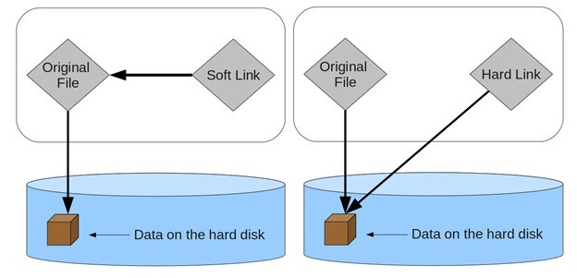

Slide 51
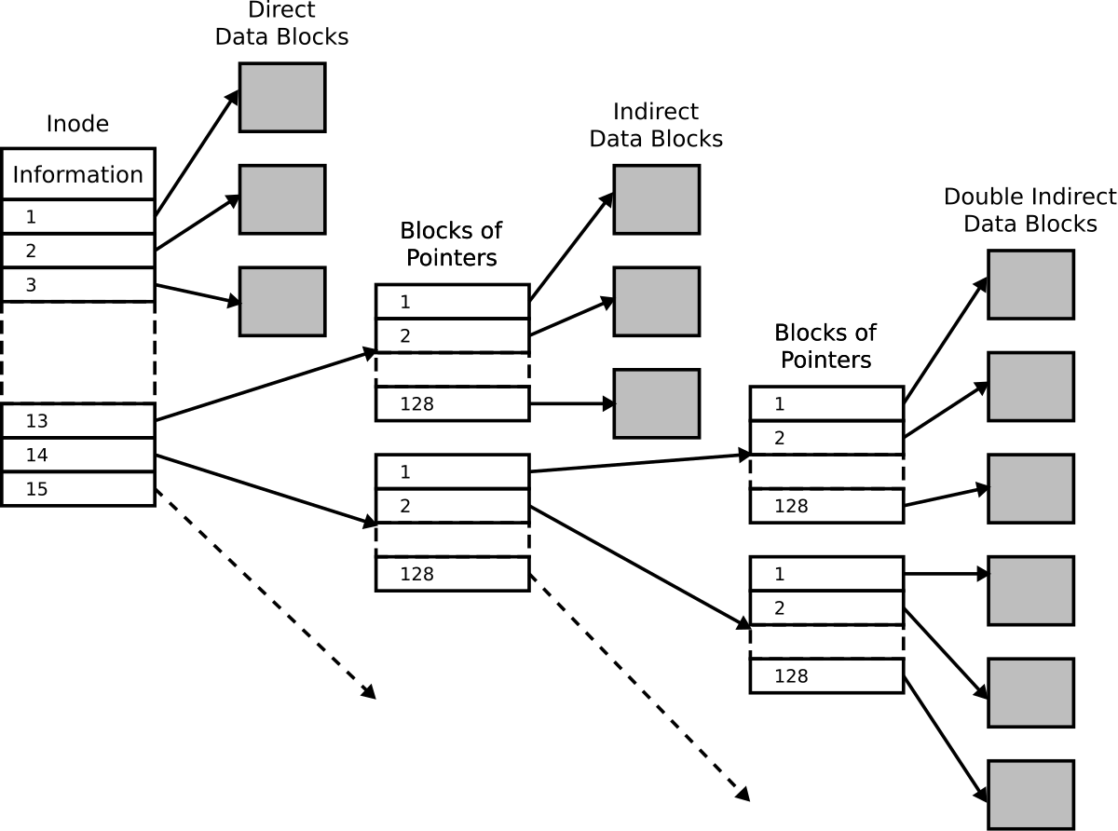

Slide 52
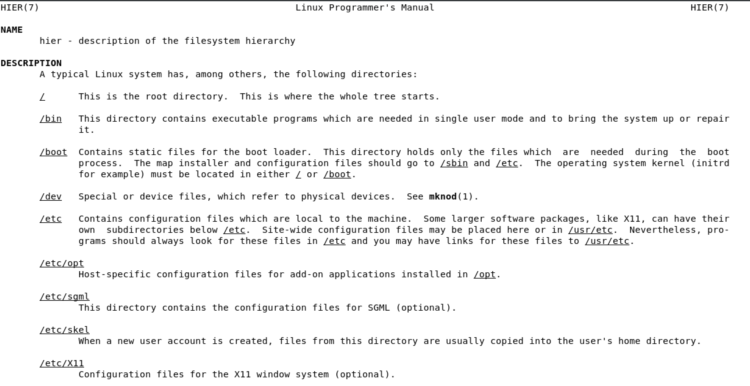

Slide 53
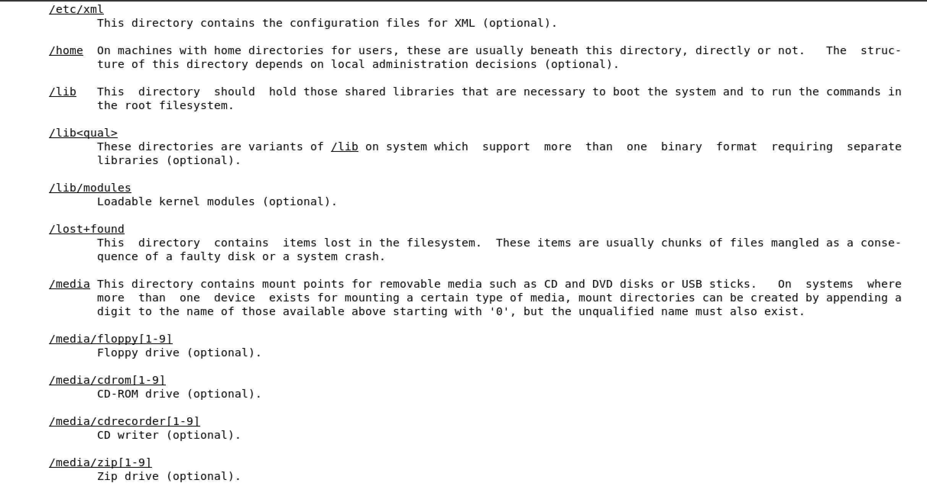

Slide 54
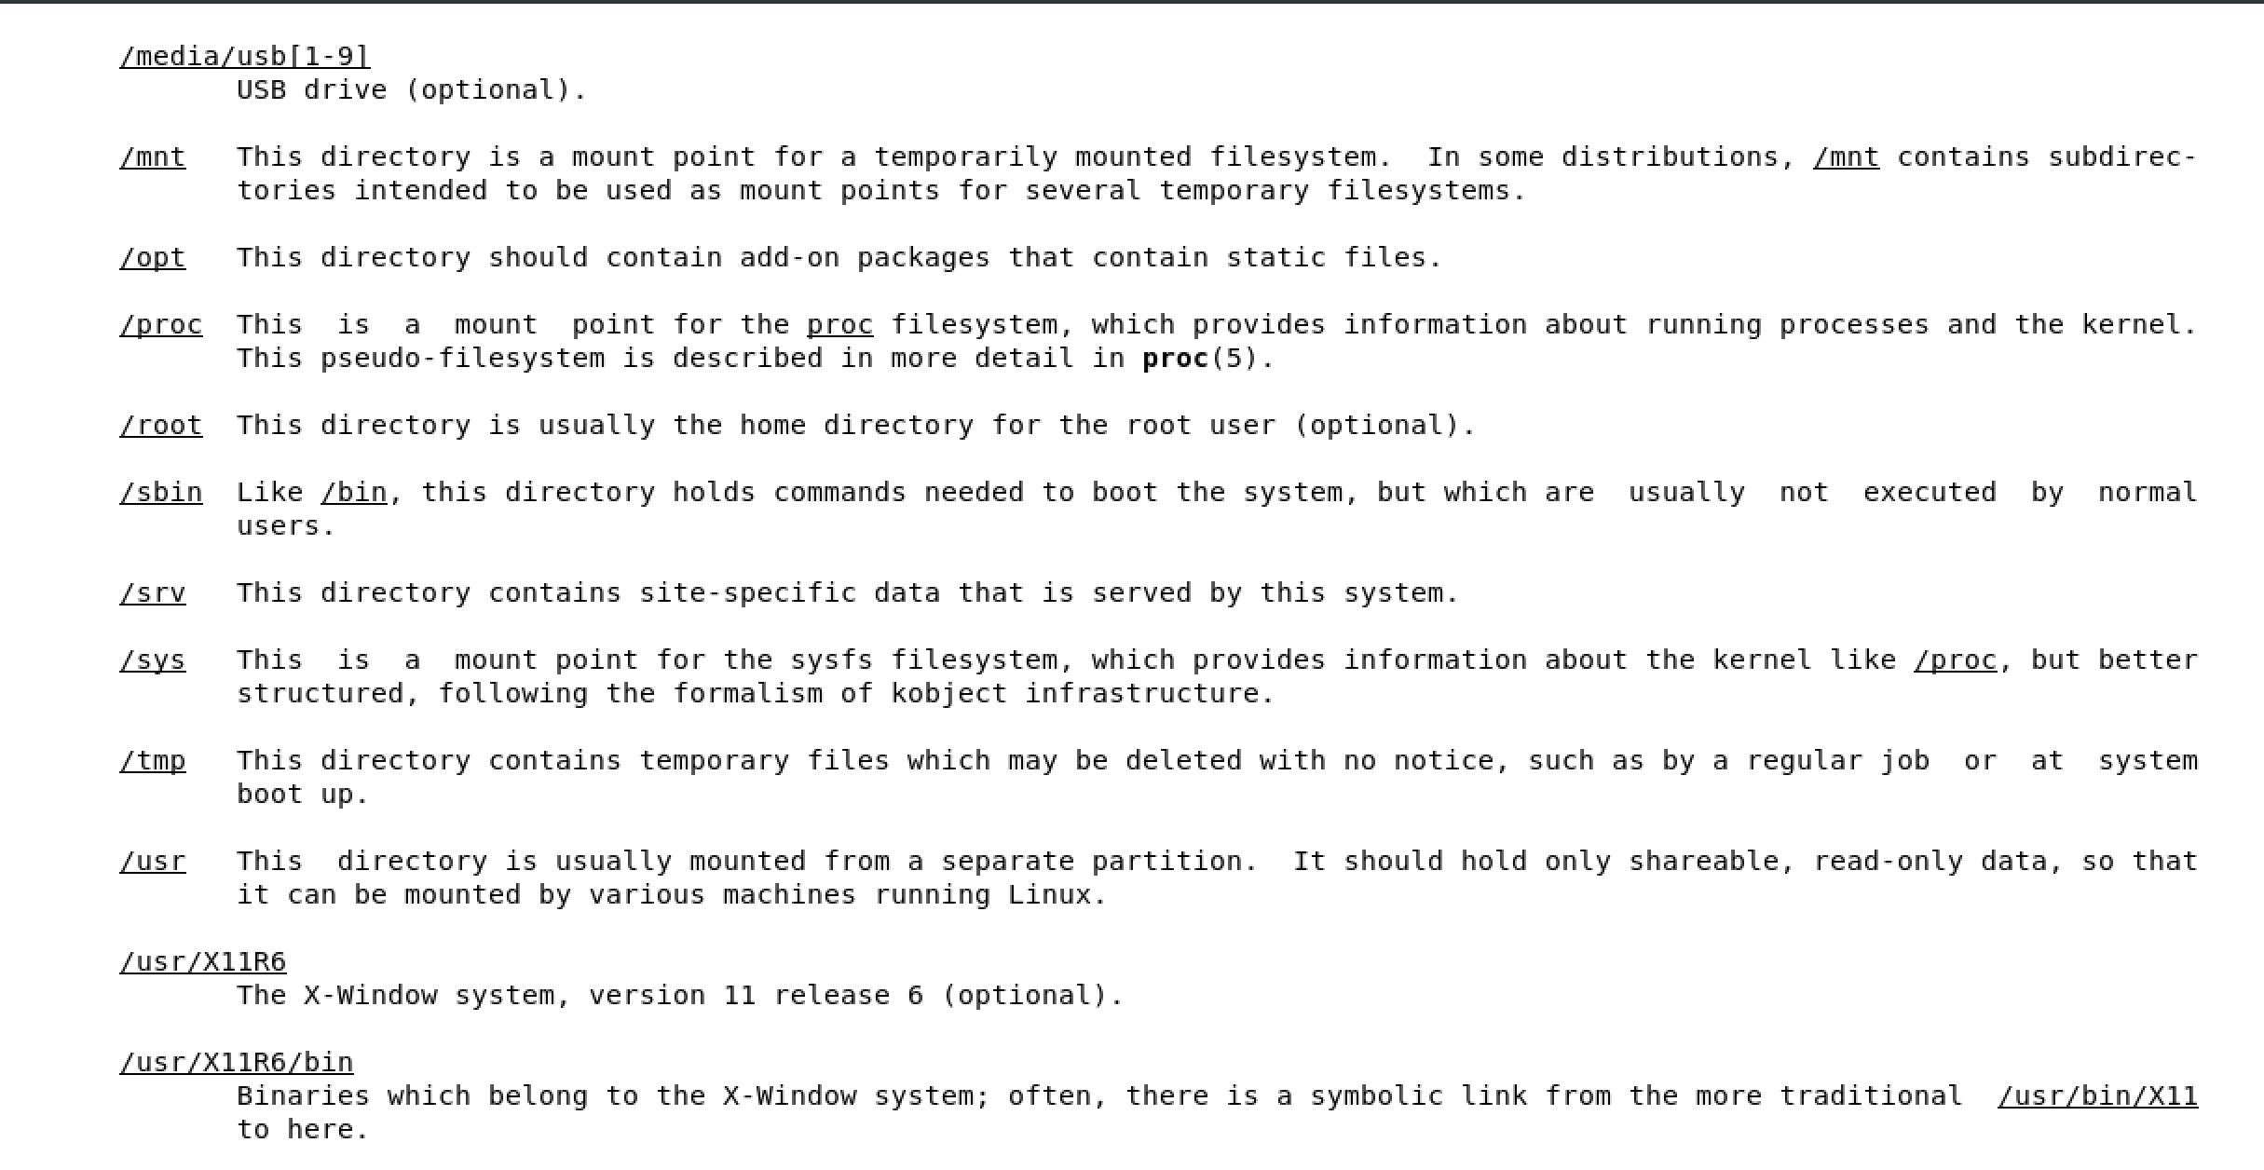

Slide 55
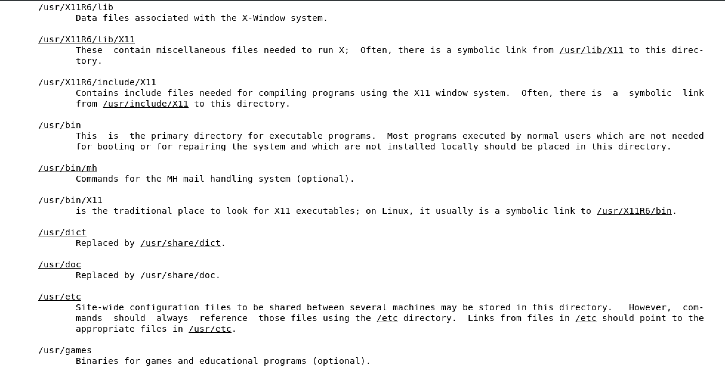

Slide 56
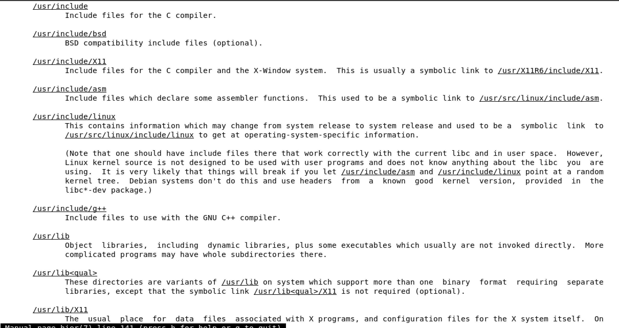

Slide 57
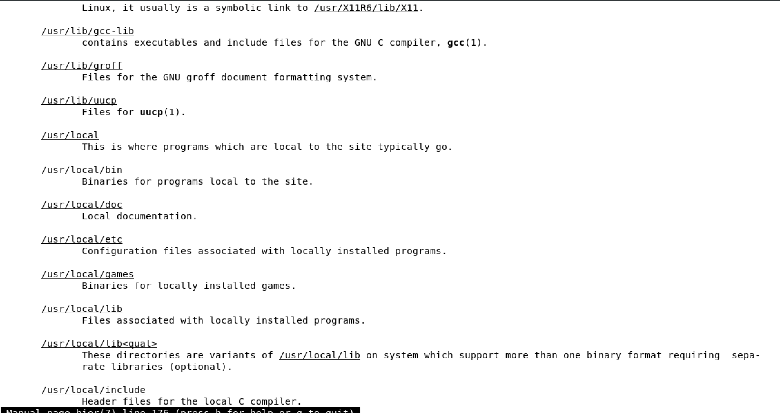

Slide 58
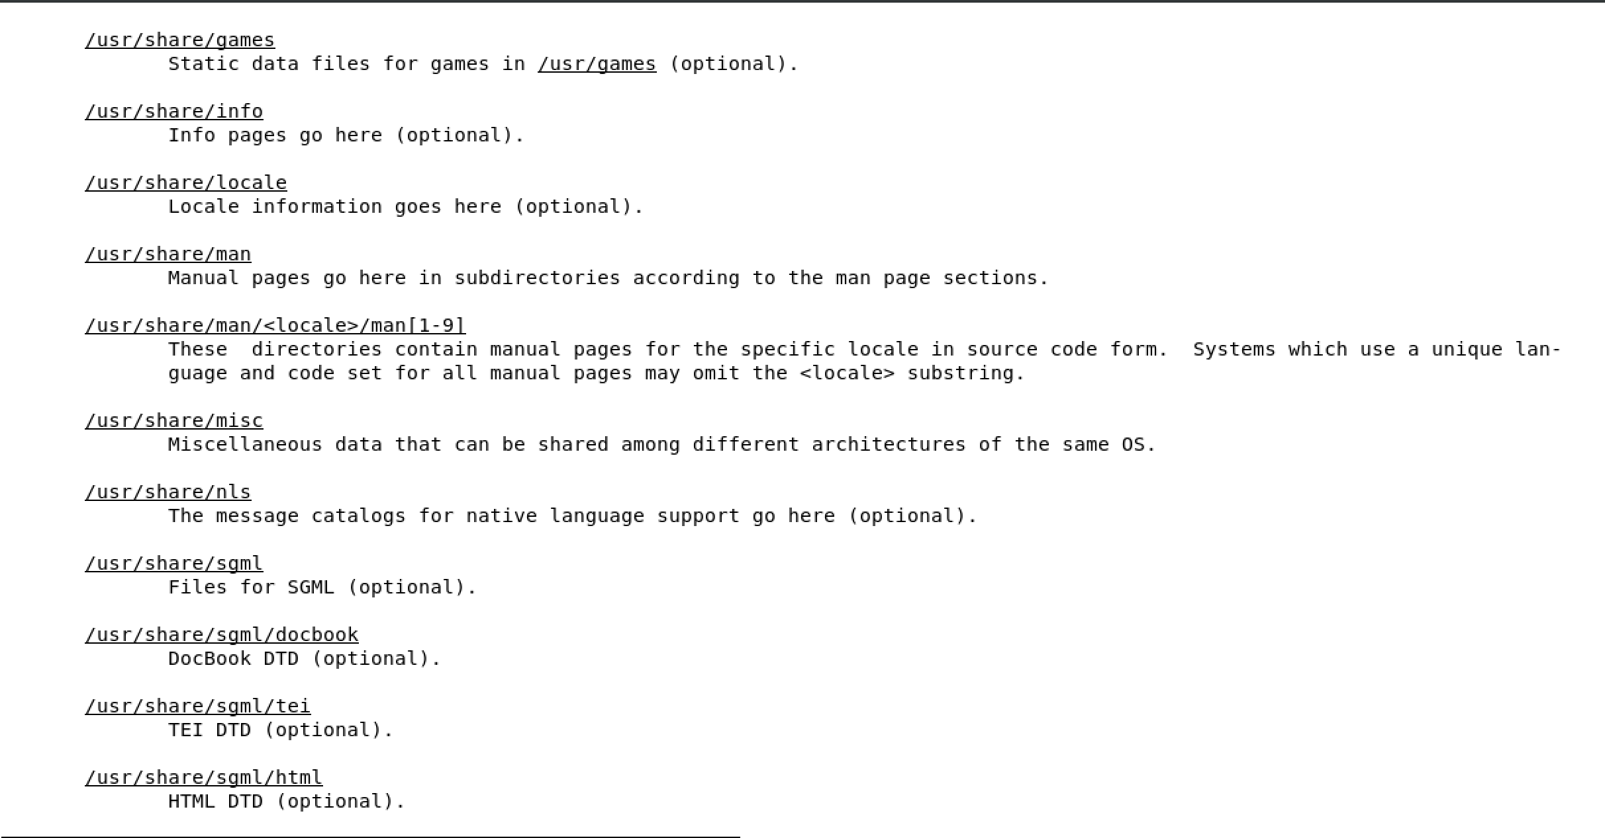

Slide 59
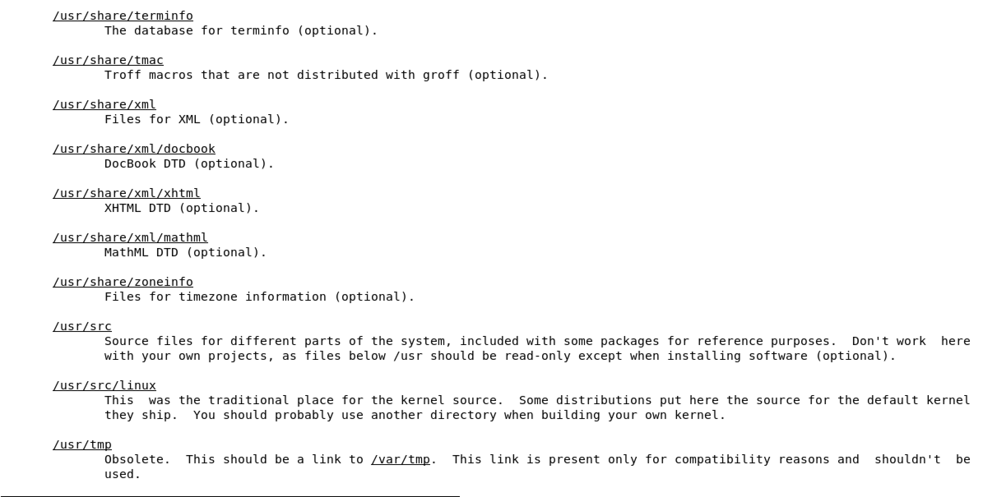

Slide 60
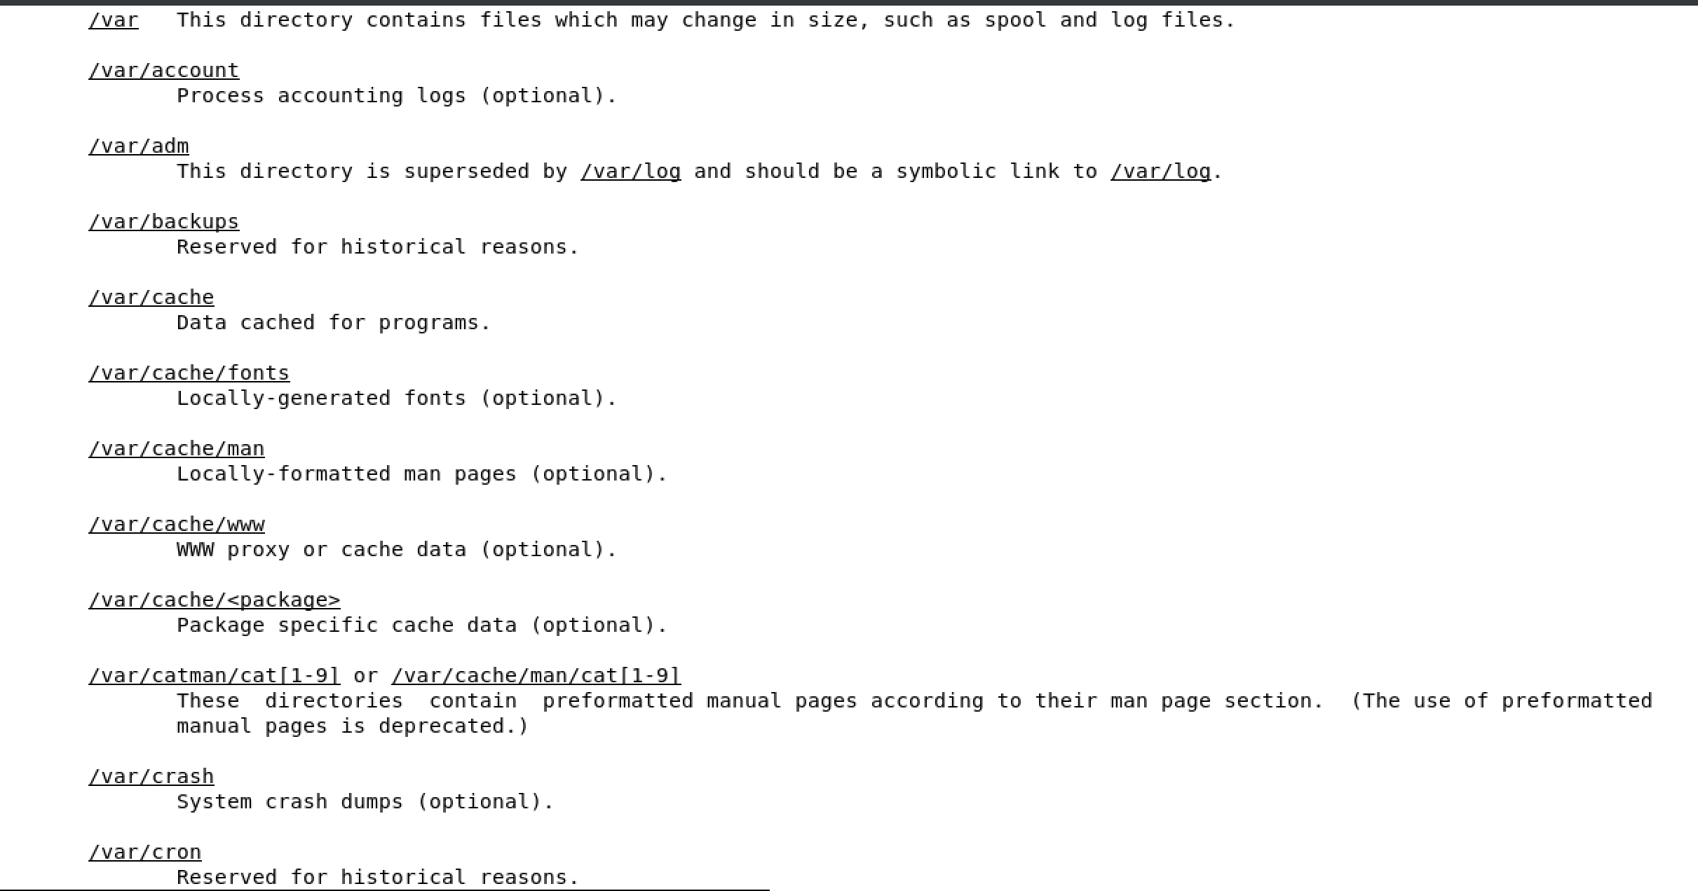

Slide 61
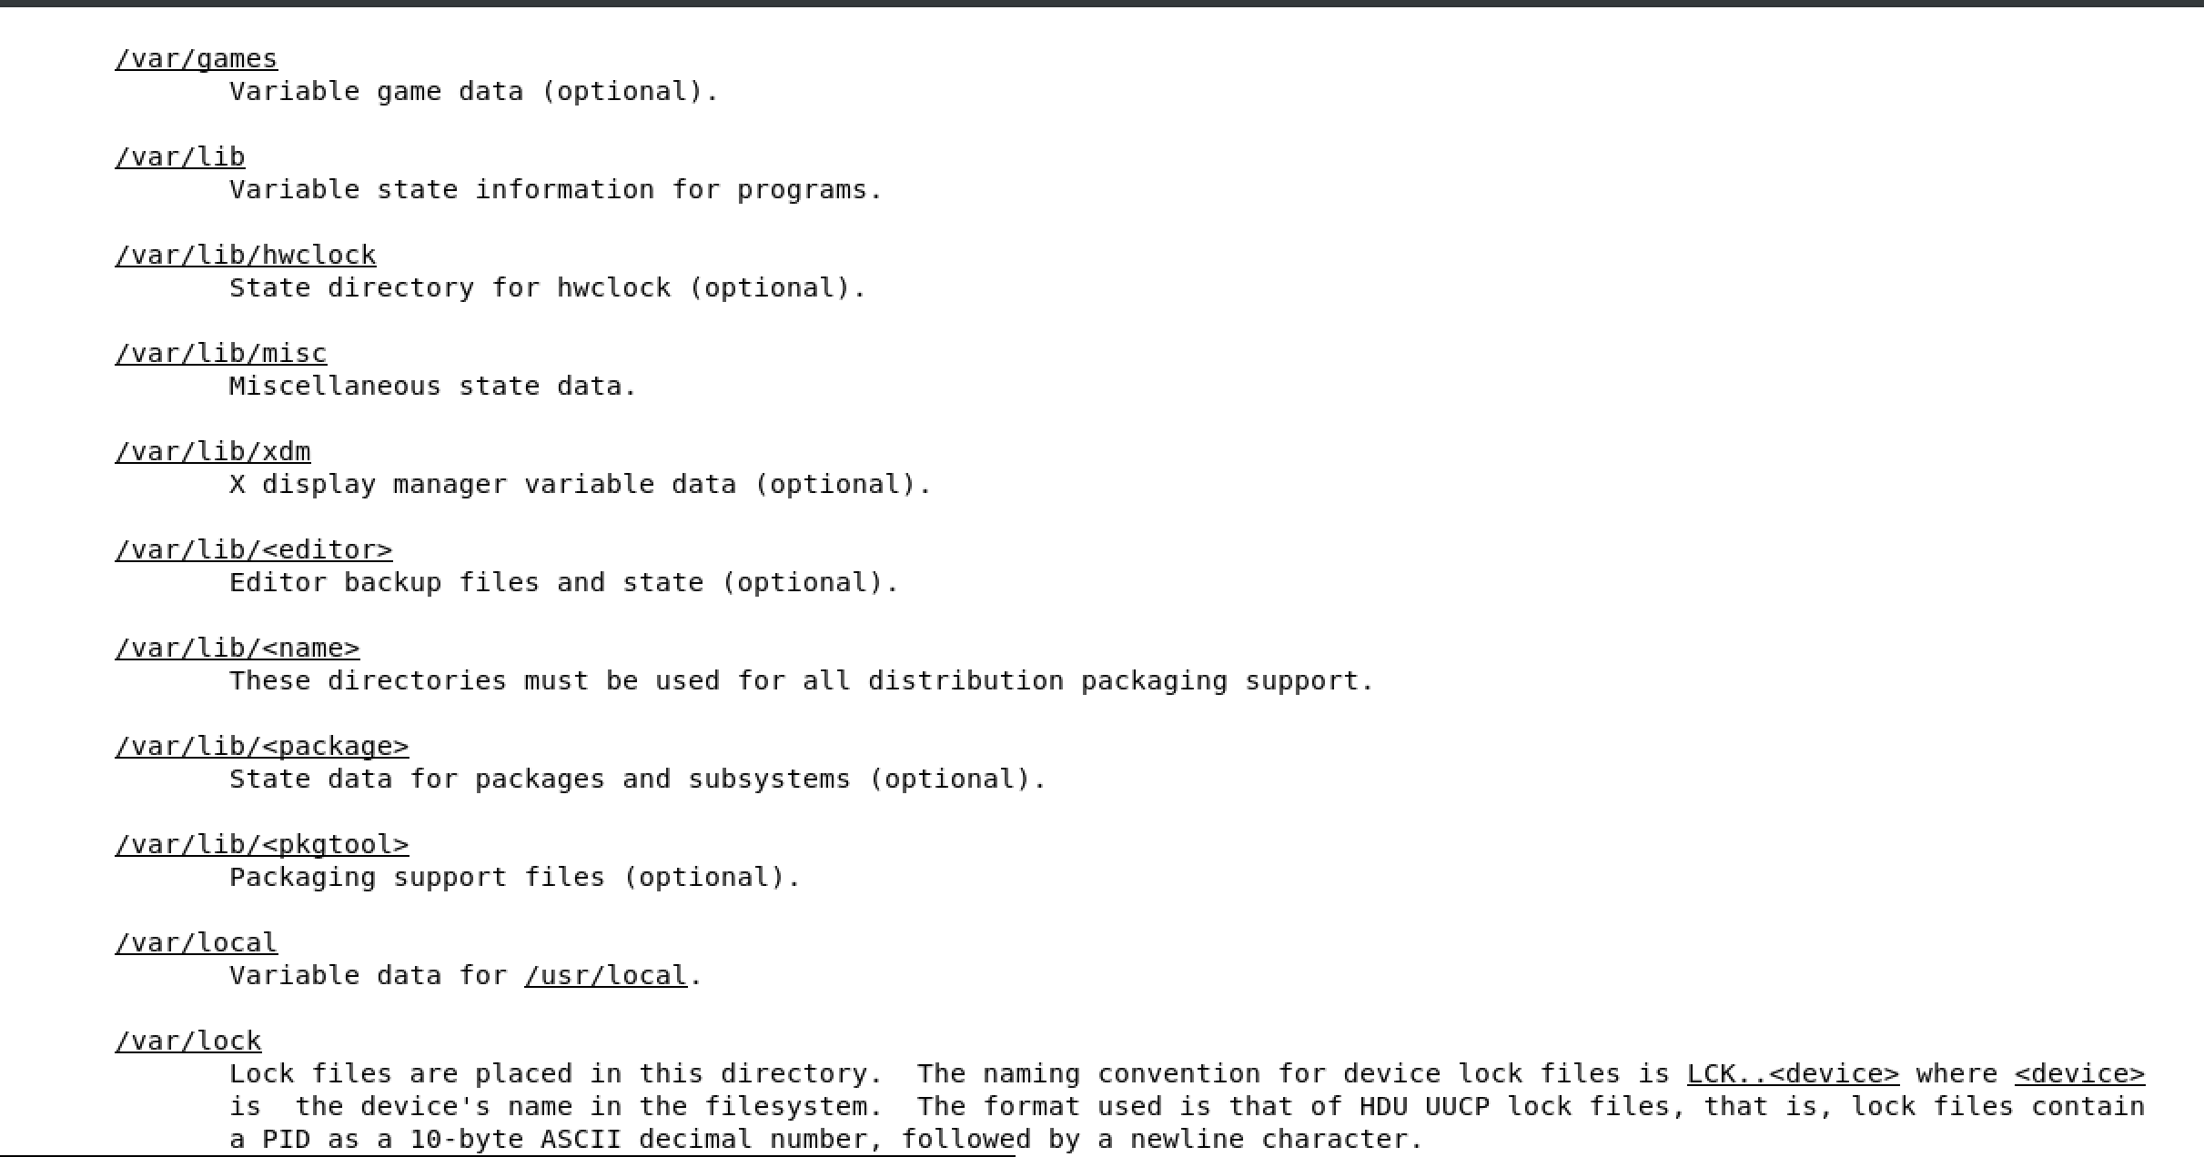

Slide 62
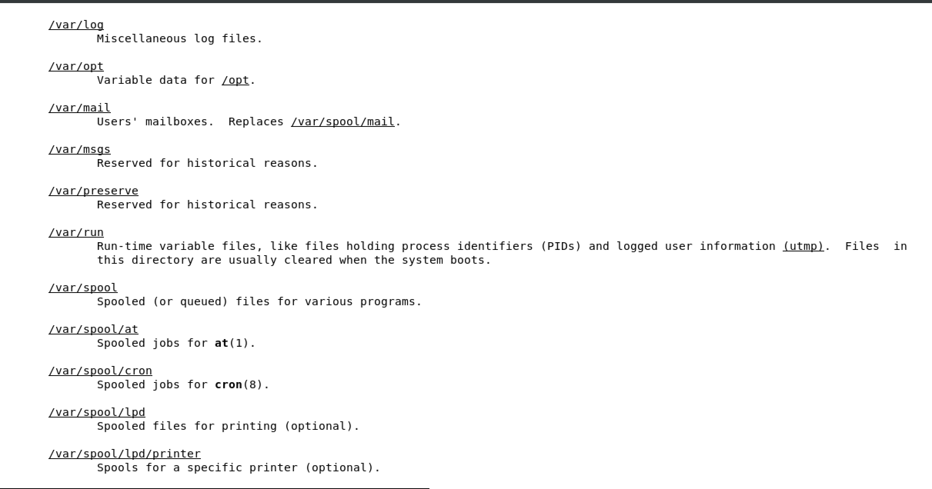

Slide 63
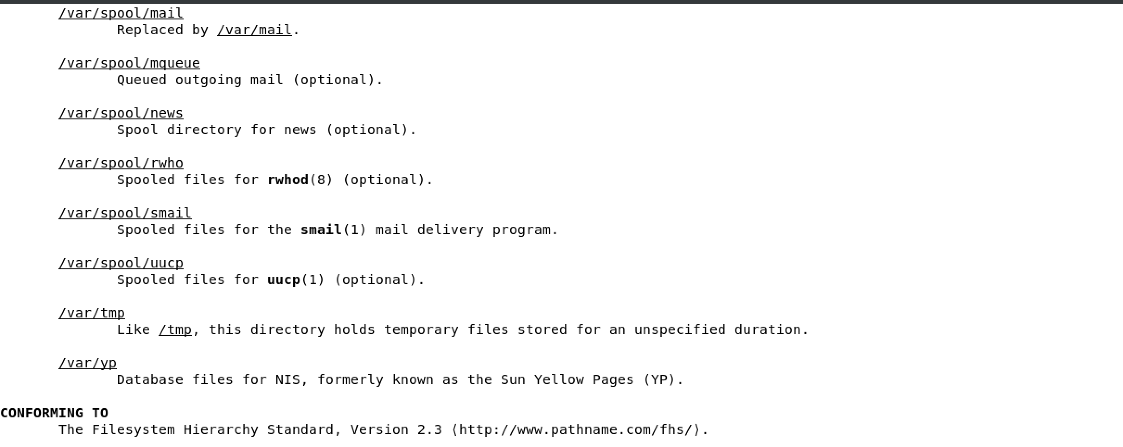

Slide 64
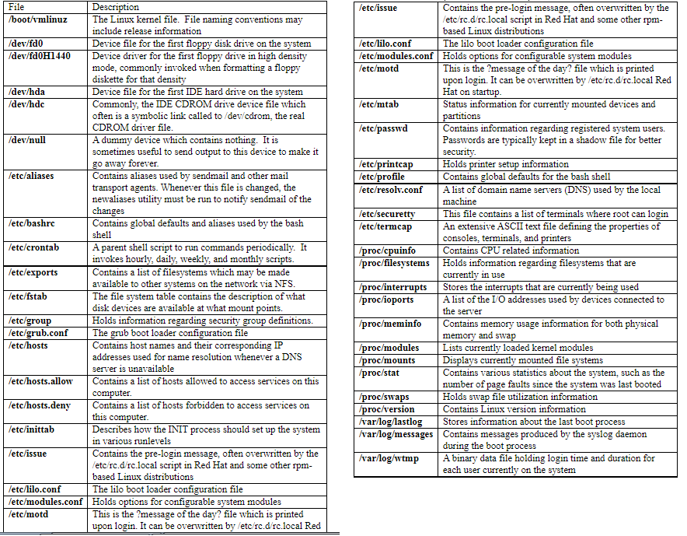

Slide 65
What is a Process?
• A process is just an instance of a running program.
• Not just a "program" - it is being executed.
• Not just a "running program", as you can execute the same program multiple times.
• These would be multiple processes running an instance of the same program.
• Example: if you open more than one terminal (windows or tabs), you are running multiple processes of your shell.
• You can execute echo $$ to see the process of the current running shell.

Slide 66
Processes have a unique "Process ID" (PID) when created.
• The PID allows you to distinguish between multiple instances of the same program.
• There are countless ways to discover the PID, as well as what processes are running.
• These methods often depend on how much information you want, as well as what your user privileges are.

Slide 67
Identification: ps Process Snapshot
ps [options]
Reports a snapshot of the current running processes, including PIDs. - By default, only the processes started by the user.
Use -e to list every process currently running on the system. –
Use -ely to get more information than you can handle.
Use -u to list all processes for user username. - Note: very different for BSD/OSX, read the man page...
To see more information about a process, pipe through grep.
For example: ps -e | grep firefox shows us the results about firefox processes.

Slide 68
lsof List of Open Files
lsof [options] - Very similar to ps, with more information by default. - Frequently used for monitoring port connections... - Use -i to list IP sockets.
E.g. lsof -i tcp:843 shows all tcp processes on port 843. - Many options...read the man page if you are intrigued.
• As with ps, often best served with a side of grep.
• More useful for administration, especially when managing a networked environment.

Slide 69
Resource Usage
Display and Update top CPU Processes top [options] - Displays the amount of resources in percentages each process is using.
Use -d to control the update frequency. - The act of monitoring is an expensive process...
Use -u to show only the processes owned by user. - Use -p to show only the statistics on process with id number PID.
When used in conjunction with ps or lsof, can be a very powerful analysis tool.
• Example sequence on the next page.

